Slide 1
GoTo Foods
Forecasting and Optimizing Pretzel Baking Time
Final Presentation – April 22nd, 2026
Notes:
Ben

Slide 2




Team Members
Ruben Lazell
Siji Akinkugbe
Ben Meiner
Xiaojia Ren
Notes:
Ben

Slide 3
Project Overview
Notes:
Ben

Slide 4
Overview of Auntie Anne’s Current Operational Process
Currently, GoTo Foods does not have a tool to forecast pretzel demand for Auntie Anne’s
Demand for Auntie Anne’s pretzels can vary throughout the day, from week to week, or even seasonally
Auntie Anne’s operational flow requires time to proof, shape, and bake various pretzel SKUs – a lack of forecasting can lead to delays in serving customers

Slide 5
Business Problem Definition – Our Goal
To meet hourly customer demand subject to Auntie Anne’s store-level production operations constraints
Notes:
Ben

Slide 6
Recommended Forecast and Optimization Pipeline
We recommend implementing a tuned demand forecasting model to predict hourly store-level demand
Predicted hourly demand would then be used to create and optimize baking and store operations
Run forecasting model on designated day for the following week (Monday through Sunday)
Generated predictions then fed into optimizer for baking schedule generation for each store
Baking schedules sent out to store management for operational oversight
Repeat at same time the following week and so on…
Notes:
Modify slightly and move to the top

Slide 7
Overview of Transactional Data and Exploratory Data Analysis
Notes:
Siji

Slide 8
The Data of Interest is Auntie Anne’s Store Transactional Data
Source:
Transactions data generated at time of sale
Unique Identifier:
Store ID, Business Date, Check Number, Check Line Number
Key Information:
Store location, location type, date and time of transaction, item quantity, cost, and item category/sub-category
Filtering:
Initial removal of airport venue type, then remove all categories except classic pretzels and pretzel nuggets for modeling
EDA Goals:
Understand location sales trends, popularity of different product types, sales performance across venue types, sales performance throughout the day

Slide 9
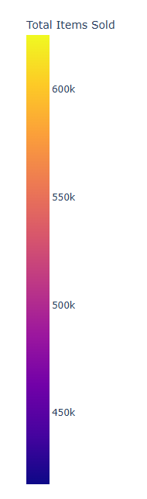
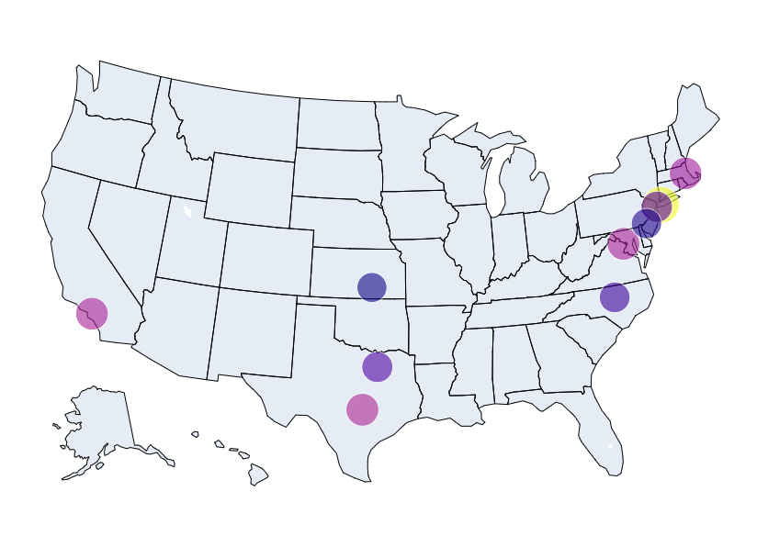
Top 10 Stores in Demand since January 2024
First, we want to understand overall store performance, focusing on the top 10 stores in total sales since January 2024
See that there is a large concentration of high performance in the Northeast
Both Texas and New York have two of the best-performing stores, indicating strong markets and potential opportunities for future growth
States:
California
Kansas
Massachusetts
North Carolina
New Jersey
New York (2)
Texas (2)
Virginia

Slide 10
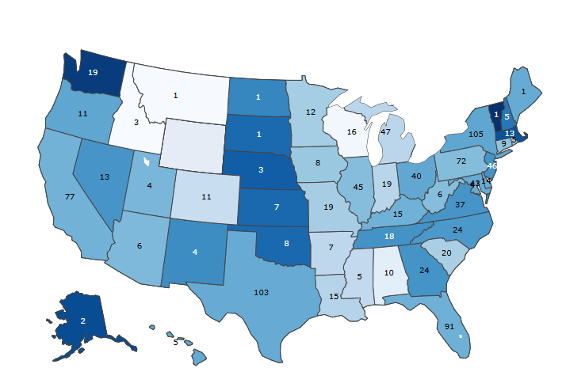
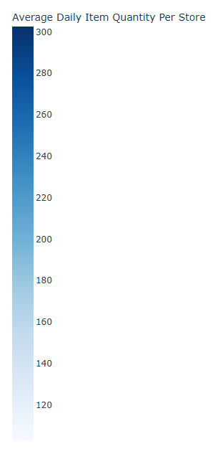
Future Focus on High Demand States with Fewer Stores
Also important to look at future growth opportunities where forecasting can be even more useful
Goal here is to find markets with high average demand but with few stores, indicating potential for more stores
See that Alaska, the Midwest and the Northeast have very high demand but fewer stores, specifically North and South Dakota, Vermont, and Maine
*State Labels Represent Number of Stores

Slide 11
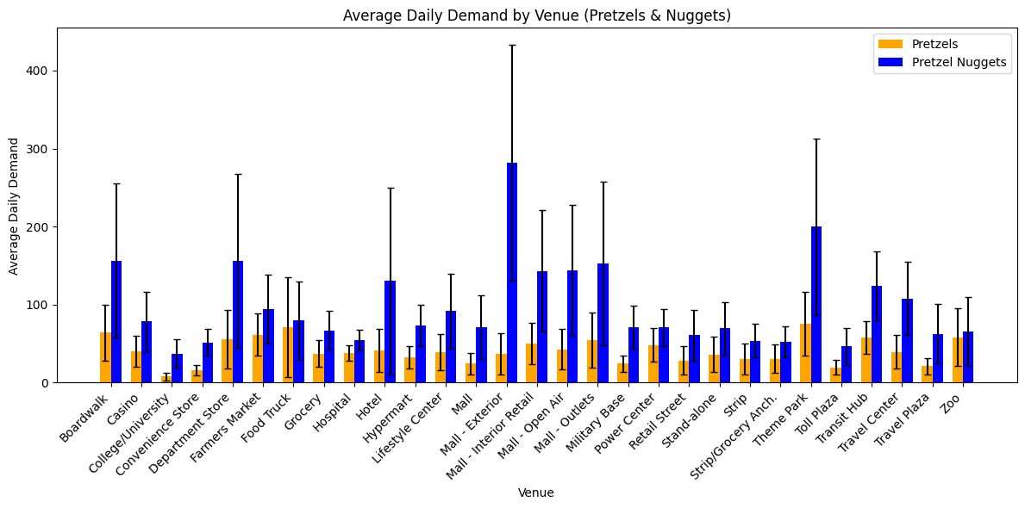
Average Daily Demand by Venue Type Shows Strong Variance
Mapps appear to have some of the largest demand on average compared to other venue types, but with strong variance
Understanding venue trends helps to better understand forecasting variations at the venue-level

Slide 12
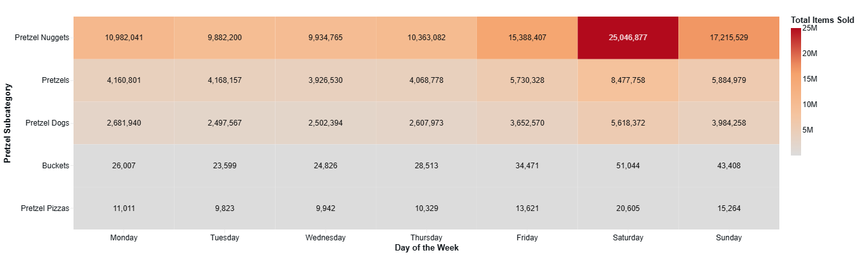
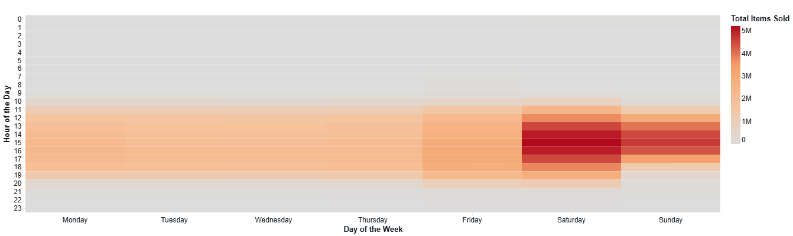
Demand is Highly Concentrated Around the Weekend
Analyzing demand throughout the week and at the hourly level further helps understand future forecasting, especially on different days and at different times
See that the largest demand falls on the weekend, with Saturday being the busiest day
2pm – 4pm are the highest-selling hours throughout the week as well

Slide 13
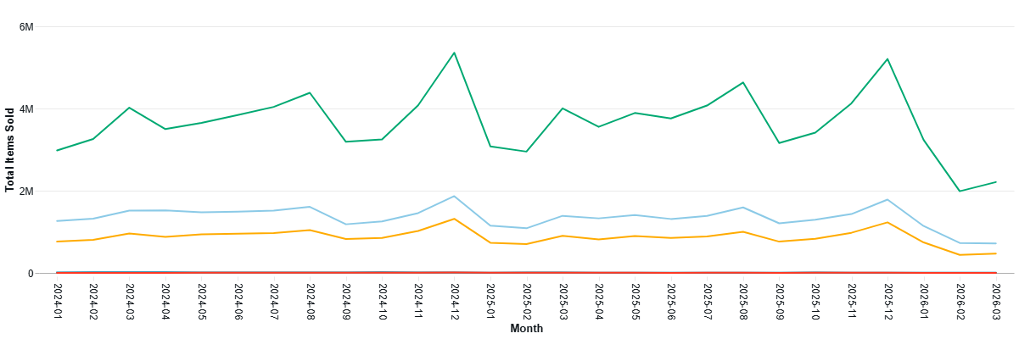
Winter Holidays and Summers Spike Demand
Demand is seasonal, with spiks and drop-offs occurring during the summer and winter months
Spikes likely correspond with summer breaks and winter holidays, times in which individuals are often more free to shop

Slide 14
Predictive Modeling
Notes:
Xiaojia/Ruben

Slide 15
Master Dataset – Adjusting Transactional Data to Finer Grain
For our modeling, we restructured the transactional data to a new grain:
Pretzel or Nugget Sales for a given hour on a given day of the week for a given store
We then performed filtering to remove values not of interest or that were out of scope
Filtered out airport data
Limited sub_category_name to only "Pretzels" & "Pretzel Nuggets"
Removed any rows where demand was in the 99.5th percentile or above
Limited modeling to only standard opening hours (10am to 10pm)
We then worked to add additional variables to assist with modeling and help improve the model

Slide 16
Features in Master Dataset
1.) Store & Location Variables:
Store id
Venue / DMA / City / State
2.) Calendar & Time Features:
Hour of day
Day of week
Weekend indicator
Holiday flags
Opening/Closing Hour flags
Daypart
Cyclical hour of day
3.) Historical Sales Signals (Lag Features)
1, 2, 3, 4 week lagged sales + Std
4.) Rolling Trend Features
same-slot 2–4 week rolling avg / std / min / max
previous 1–4 week all-hour avg / std / min / max
multi-week smoothed all-hour avg / std features
5.) Features Computed in Training
Overall store average
Store-time interaction averages (store-hour, store-day-of-week, store-daypart)
Store-context averages (store-hour-weekend, store-hour-day-of-week)

Slide 17
Exploration of Model Algorithms
To forecast demand, we first created a simple linear regression model, then ramped up complexity via tree-based models for prediction generation
Model Types Include (From Simplest to Most Complex):
Linear Regression
Random Forest
LightGBM
XGBoost
LSTM + XGBoost
LSTM Captures time dependencies while XGBoost learns the patterns/effects
After initial runs, settled on XGBoost due to performance and tunability

Slide 18
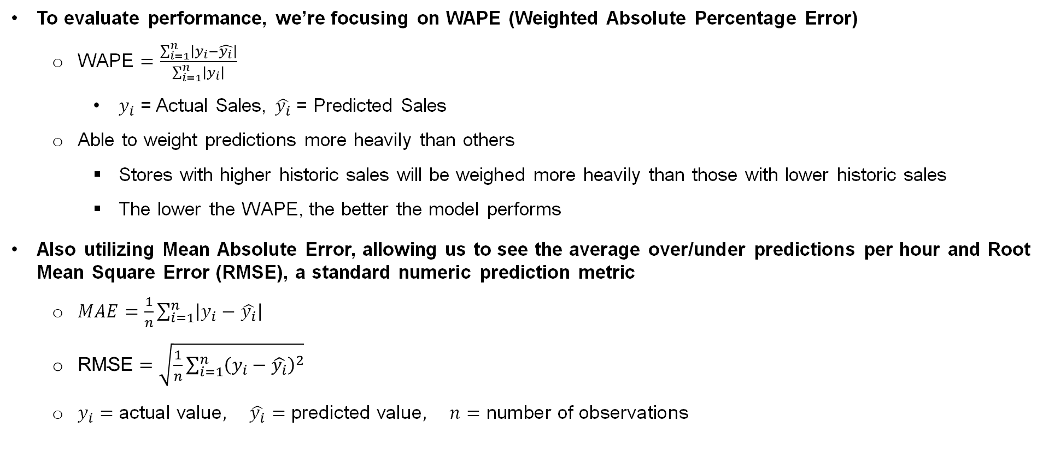
Metrics Used for Evaluating Models
To evaluate performance, we’re focusing on WAPE (Weighted Absolute Percentage Error)
$\text{WAPE}=\frac{\sum_{i=1}^{n}{\left|y_{i}−\hat{y_{i}}\right|}}{\sum_{i=1}^{n}{\left|y_{i}\right|}}$
$y_{i}$ = Actual Sales, $\hat{y_{i}}$ = Predicted Sales
Able to weight predictions more heavily than others
Stores with higher historic sales will be weighed more heavily than those with lower historic sales
The lower the WAPE, the better the model performs
Also utilizing Mean Absolute Error, allowing us to see the average over/under predictions per hour and Root Mean Square Error (RMSE), a standard numeric prediction metric
$MAE=\frac{1}{n}\sum_{i=1}^{n}{\left|y_{i}−\hat{y_{i}}\right|}$
$\text{RMSE}=\sqrt{\frac{1}{n}\sum_{i=1}^{n}{{\left(y_{i}−\hat{y_{i}}\right)}^{2}}}$
$y_{i}=\text{actual} \text{value}, \hat{y_{i}}=\text{predicted} \text{value}, n=\text{number} \text{of} \text{observations}$

Slide 19
After Additional Tuning, XGBoost Outperforms All Models
 | Pretzel RMSE | Pretzel MAE | Pretzel WAPE (daily) (%) | Nugget RMSE | Nugget MAE | Nugget WAPE (daily) (%)
Linear Regression | 2.30 | 1.09 | 10.1% | 4.66 | 2.40 | 16.2%
XGBoost | 2.08 | 1.05 | 4.20% | 3.72 | 2.07 | 6.60%
XGBoost performed best compared to other more complex models
Then tuned model, focusing on daily WAPE instead of hourly and also evaluating on RMSE
Being a tree model and an ensemble method, it is able to continuously improve by iterating over the data, with each new run more heavily weighting previously made errors (Boosting)
Able to run fairly quickly compared to other models
Notes:
Ruben

Slide 20
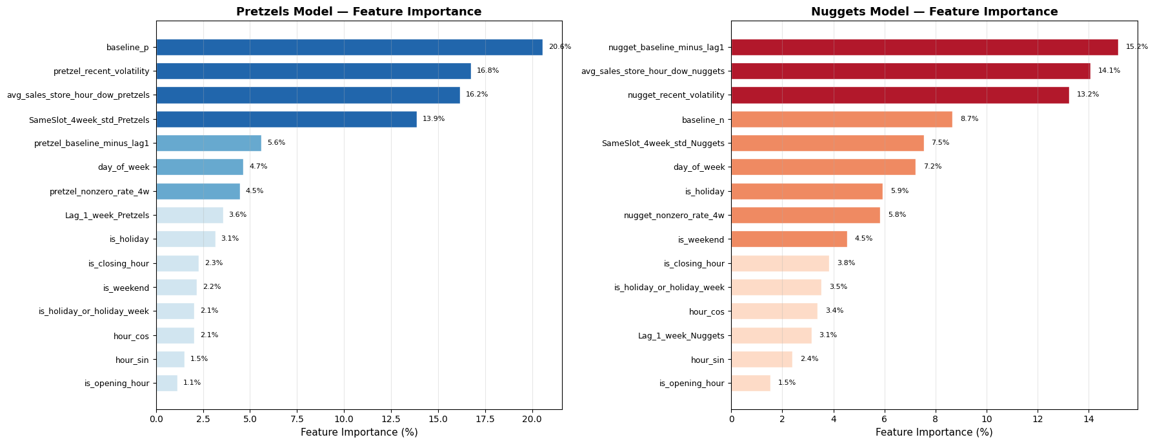
Analyzed Tuned XGBoost Feature Importance
For Pretzels –
For Nuggets –
Notes:
Ruben

Slide 21
Model Output Example
Notes:
Ruben

Slide 22
Model Deployment - Baking Schedule Optimization
Notes:
Ben

Slide 23
Next is the Creation of an Optimized Baking Schedule
Build an optimized baking schedule with the goal of answering:
How many pretzels should be baked in a given hour to meet the forecasted hourly demand throughout the day?
Available Information/Constraints
Total baking time from mixing to display = 76 minutes
Pretzels should not be displayed longer than 1 hour
Baking can start 2 hours prior to opening (8am for a 10am opening)
Waste should be minimized
Penalize for pretzels being held and sold in the next hour window if baked in ready in previous hour

Slide 24
Today’s Operational Process Used for Model
Add Topping
Customer arrives at Auntie Anne’s
Nugget
Add Stuffing
Customer orders pretzel product (nugget or classic)
*Is pretzel stock running low?
Mix Ingredients
(6 minutes)
Proof
(30-45 minutes)
Shape
(5 minutes)
Yes
No
Classic
Add Topping
Transaction complete and data captured
Employee enters transaction into terminal and generates receipt
Employee retrieve’s fresh pretzel from display and delivers to customer
Display
(< 1 Hour)
Bake
(10 min)
Rest
(5-20 min)
*Pretzels baked according to optimized baking schedule – will inform staff of when stock will be low/out to ensure fresh pretzels are always available for customers

Slide 25
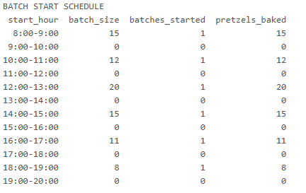
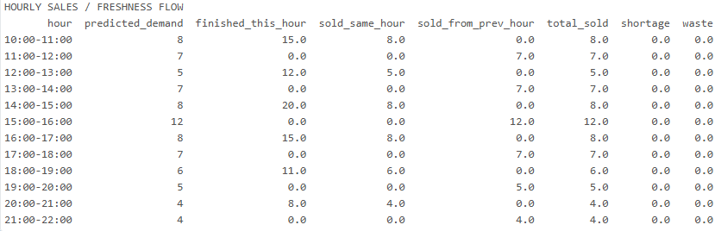
Baking Schedule Optimization Output
Utilized a Gurobi Optimizer
Variable batch sizes to meet demand given operational constraints
Overall objective is to minimize “cost” with assigned costs for production, holding, shortage, and waste
Higher cost for shortage (not meeting demand) than waste (pretzels that are past the allotted display time or unsold at end of day)
General Structure:

Slide 26
Employing an Optimization Model Maximizes Profit Potential
Minimizes wastage and ensures demand is met allowing profits to be maximized due to reduced wastage costs
An optimized schedule ensures pretzels are as fresh as possible, increasing customer satisfaction
Limitations added to reduce wastage as much as possible, with it frequently eliminated all together
Assists staff with knowing exactly how many pretzels to bake within a given hour, reducing uncertainty
Schedules are optimized for each day, ensuring staff are prepared for baking on higher-volume days
Store management can ensure stores are staffed appropriately based on higher-volume or lower-volume predictions

Slide 27
Model Output Example – 75th Percentile Store
Notes:
Ruben

Slide 28
Future Predictions

Slide 29
Baking Optimization

Slide 30
Summary and Future Considerations
Notes:
Ben

Slide 31
In Summary – Auntie Anne’s Should Utilize Forecasting to Optimize Baking Schedules
Utilize Historic Transactions Data to Forecast Demand
Best model is able to predict daily demand with only about 5% error for pretzels and pretzel nuggets
Feed Hourly Forecasts into Optimization Model for Ideal Baking Schedule
Optimization Model minimizes display times and wastage to ensure pretzels are fresh and baked to match demand

Slide 32
Possible Future Work Includes Supply Chain Integration
In future work, we’d recommend further refining the optimization model to factor in supply chain considerations and expanding forecasting to additional pretzel categories
Look at incorporating Safety Stock for Demand Uncertainty and Periodic Review Considerations
Factor in Ingredient and Supply Distribution and Location Optimization Techniques
Explore Perishability as an Optimization Factor
Implement Hard Baking Constraints Tailored to Store Specifications
Expand Forecasting to All Pretzel Subcategories

Slide 34
Appendix

Slide 35
Still Several Risks with an Optimized Baking Schedule and Hourly Forecasting
Forecasting Risks
Optimization Risks
Forecasting isn’t always perfect, and demand may fluctuate from the forecast
Optimization is designed to produce the optimized number of pretzels for a given hour based on forecast
Higher risk for 0-demand predictions, which may lead to store vulnerability during unpredicted traffic
Working within limited display time (<1 hour) which leaves room for wastage if extra pretzels are baked
Lack of promotional data means our model is unable to account for non-seasonal demand spikes
High variance in predictions could lead to an excess or shortage in pretzels on any given day
Have designed the model to factor in seasonality and store-specific nuances as much as possible to minimize these risks
Can combat this by always building in a buffer of a set number of pretzels and factoring wastage into operating costs

Slide 36
XGBoost Technical Details
Two separate XGBoost residual models were trained:
One for pretzels
One for nuggets
Each model starts from a baseline forecast and then learns a residual adjustment, rather than predicting demand fully from scratch
Final predictions are passed through output controls to make forecasts more realistic:
Calibration adjusts for consistent over or underprediction
Zero-demand suppression forces tiny predictions to 0 when recent history, baseline demand, and raw forecast all suggest sales are very unlikely
Upper caps prevent unrealistically large predictions

Slide 37
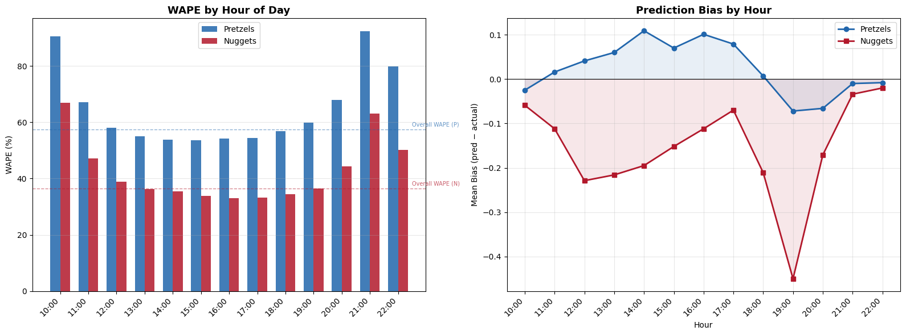
Error Pattern Analysis – Tuned Model

